Slide 1



DISEASE PREDICTION USING
MACHINE LEARNING ALGORITHMS
DISEASE PREDICTION USING MACHINE LEARNING ALGORITHMS
BATCH:5
MOHAMMED OMAIR AHMED -160722747090
MUSHAM PRAVEEN KUMAR -160722747094
LOGISHETTY VAISHNAVI -160722747116
Under The Guidance Of :
MRS K.RADHIKA
Asst. Prof, Dept. of CSE
Department of Computer Science and Engineering

Slide 2

ABSTRACT
Disease prediction using machine learning is aimed at creating a system that helps physicians to determine the illness a patient suffers from more accurately. A dataset of 4,920 patient records each diagnosed with 41 different diseases was used for the study. Analyses focused on 95 of the 132 symptoms that were selected as key symptoms associated with different diseases over a variety of complex diseases. The development of the system was done using machine learning algorithms which are capable of diagnosing diseases by recognizing patterns in the data.
Department of Computer Science and Engineering

Slide 3

INTRODUCTION
Many life-threatening diseases like diabetes, malaria, jaundice, and dengue begin with common symptoms such as fever, headache, and fatigue. People often self-diagnose or delay medical consultation, which can lead to late detection and poor outcomes.
This project suggests a Machine Learning-based Disease Prediction System using algorithms like Decision Tree, Random Forest, and Naive Bayes to predict diseases based on user-input symptoms. The goal is to support timely and accurate diagnosis, assist healthcare professionals, and improve overall treatment outcomes.
Department of Computer Science and Engineering

Slide 4
PROBLEM STATEMENT
Early disease diagnosis is difficult due to overlapping symptoms, limited expert access, and time constraints in busy clinical settings. Existing systems are narrow in scope and lack symptom-based flexibility. This project aims to build an ML-based model that predicts diseases from multiple symptoms, improving diagnosis speed, accuracy, and support for physicians.
Department of Computer Science and Engineering

Slide 5
OBJECTIVES
Disease Prediction: Create an ML-based disease prediction system based on symptoms.
Dataset Analysis: Investigate symptom–disease data to find the most important patterns.
Symptom Optimization: Determine the most effective symptoms to make accurate predictions.
Department of Computer Science and Engineering

Slide 6
LITERATURE SURVEY
SNO | Title | Techniques | Methodology | Performance | Research Gaps | System Architecture
1 | Disease Prediction using Machine Learning Algorithms (Sneha et al., 2020) | Decision Tree, Random Forest, Naïve Bayes | Comparative study of classifiers using symptoms dataset (4920 patient records, 95 symptoms, 41 diseases) | Accuracy: 95.12% | Overfitting issue with Decision Tree when using full symptoms dataset | GUI-based system; rule-based model; 3 algorithms for backend classification
Department of Computer Science and Engineering

Slide 7
SNO | Title | Techniques | Methodology | Performance | Research Gaps | System Architecture
2 | The Prediction of Disease Using Machine Learning (Gomathy et al., 2021) | SVM, Naïve Bayes, KNN, Decision Tree, Random Forest | Hybrid algorithm approach for chronic disease prediction using structured data | Accuracy: RF – 98.95%, SVM – 96.49%, NB – 89.4% | Limited scope to specific chronic conditions; structured data only | Web-based system; predictive backend with multiple ML classifiers
Department of Computer Science and Engineering

Slide 8
SNO | Title | Techniques | Methodology | Performance | Research Gaps | System Architecture
3 | Disease Prediction using ML (Pramod Reddy et al., 2021) | Random Forest | Chronic disease prediction using structured/unstructured data; Flask-based model deployment | Diabetes: 98.25%, Kidney: 99%, Heart: 85.25%, Liver: 78% | Lower performance for certain diseases (e.g., Liver); lacks multi-model comparison | Flask-based web app; ML backend with disease-specific random forest classifiers
Department of Computer Science and Engineering

Slide 9
SNO | Title | Techniques | Methodology | Performance | Research Gaps | System Architecture
4 | Disease Prediction Using ML Techniques (Vamsi Krishna et al., 2024) | Random Forest | Predicts chronic diseases using structured hospital data and symptom-based models | High accuracy reported for 5+ major diseases | Model not tested for scalability across diverse diseases | Python-based system; backend built using VScode with Random Forest classifier
Department of Computer Science and Engineering

Slide 10
SNO | Title | Techniques | Methodology | Performance | Research Gaps | System Architecture
5 | Disease Prediction and Drug Recommendation Using ML (Authors Unknown, 2023) | Random Forest, Decision Tree, Logistic Regression | Integrates symptom-based disease detection with drug recommendation using ML | Claims high performance; details vary by use case | Claims high performance; details vary by use case | Integrated web interface for prediction and drug suggestion
Department of Computer Science and Engineering

Slide 11
METHODOLOGY
Symptom Input
User selects symptoms from a predefined list of 95 significant symptoms, enabling structured data input for diagnosis.
Data Preprocessing
Cleans and refines patient data by handling missing values and reducing dimensionality from 132 to 95 symptoms.
Model Training
Trains three ML models—Decision Tree, Random Forest, and Naïve Bayes—on a dataset of 4920 patient records to learn disease patterns.
Disease Predictions
The system uses trained models to predict the most probable disease based on user-input symptoms, assisting in early diagnosis.
Department of Computer Science and Engineering

Slide 12
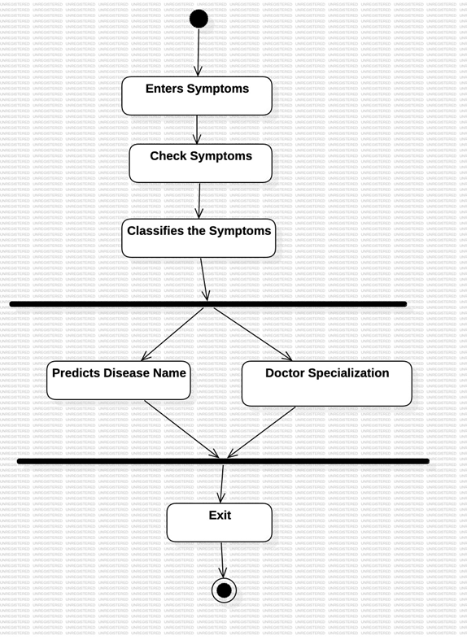
WORK FLOW DIAGRAM
Department of Computer Science and Engineering

Slide 13
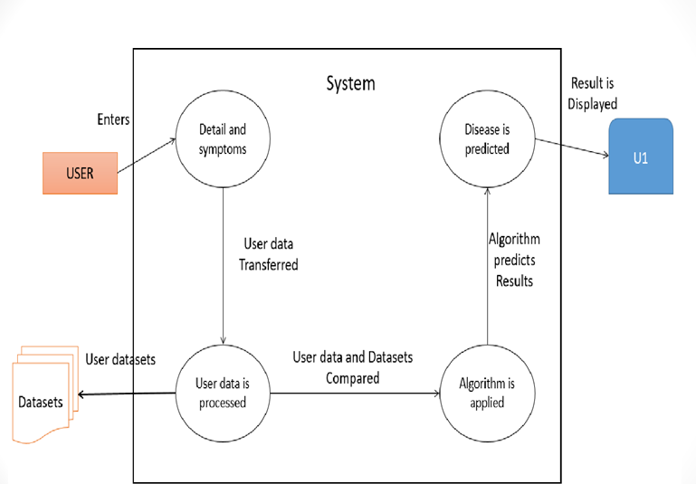
SYSTEM ARCHITECTURE
Department of Computer Science and Engineering

Slide 14
DATA SET & TOOLS
DATASETS:
4920 patients records
132 symptoms, predicting 41 diseases
Selected 95 relevant symptoms after preprocessing
TOOLS:
Python( programming language)
IDE: Python/Jupyter Notebook
Libraries:
Scikit-learn,Pandas, Numpy,Matplotlib
Department of Computer Science and Engineering

Slide 15

RESULTS
Department of Computer Science and Engineering

Slide 16
References
Esteva, A., Kuprel, B., Novoa, R. A., Ko, J., Swetter, S. M., Blau, H. M., & Thrun, S. (2017). Dermatologist-level classification of skin cancer with deep neural networks. Nature, 542(7639), 115-118.
2. Rajkomar, A., Dean, J., & Kohane, I. (2019). Machine learning in medicine. New England Journal of Medicine, 380(14), 1347-1358.
3. Choi, E., Schuetz, A., Stewart, W. F., & Sun, J. (2016). Using recurrent neural networks for early detection of heart failure onset. Journal of the American Medical Informatics Association, 24(2), 361-370.
4. Miotto, R., Wang, F., Wang, S., Jiang, X., & Dudley, J. T. (2017). Deep learning for healthcare: Review, opportunities and challenges. Briefings in Bioinformatics, 18(1), 123-136.
5. Obermeyer, Z., & Emanuel, E. J. (2016). Predicting the future—big data, machine learning, and clinical medicine. New England Journal of Medicine, 375(13), 1216-1219.
6. Razzak, M. I., Naz, S., & Zaib, A. (2018). Deep learning for medical image processing: Overview, challenges and the future. In Classification in BioApps (pp. 323-350). Springer.
Department of Computer Science and Engineering

Slide 17
Conclusion
Disease prediction using machine learning offers significant promise for improving early diagnosis, patient outcomes, and healthcare efficiency. By analyzing large datasets, these algorithms can detect patterns beyond human capability. However, successful implementation requires careful attention to ethics, data privacy, and rigorous validation. Collaboration among healthcare professionals, data scientists, and policymakers is essential to realize the full potential of this technology while maintaining high standards of care and security.
Department of Computer Science and Engineering

